Slide 1

DATABASES AND APPLICATIONS
SUBJECT CODE : UQ23CA653A
Samyukta D Kumta
Computer Applications

Slide 2
DATABASES AND APPLICATIONS
UNIT-IV- Non Relational Database Types
NoSQL databases have been developed that provide a high-performance and salable alternative to more traditional relational database management systems (RDBMS), especially when dealing with large amounts of unstructured or semi-structured data.
NoSQL, which stands for “Not Only SQL” is unlike RDBMS as it is designed for processing large collections of distributed data that don’t fit well into strict rows and columns.

Slide 3
DATABASES AND APPLICATIONS
UNIT-IV- Non Relational Database Types
NoSQL Database Typically Contain the Following Types of Data:
• Semi-structured data (CSV, Word, Excel, PowerPoint, Documents,
PDFs, Logs, XML, JSON) • Unstructured data (Emails, Text, Messages, Blog Entries, Twitter) • Binary data (Graphics, Images, Audio, Video)

Slide 4
DATABASES AND APPLICATIONS
UNIT-IV- Non Relational Database Types
NoSQL databases
There are many types of NoSQL databases.
They can be divided into four major groups:
Key-value store
Column-oriented
Document-based
Graph databases

Slide 5
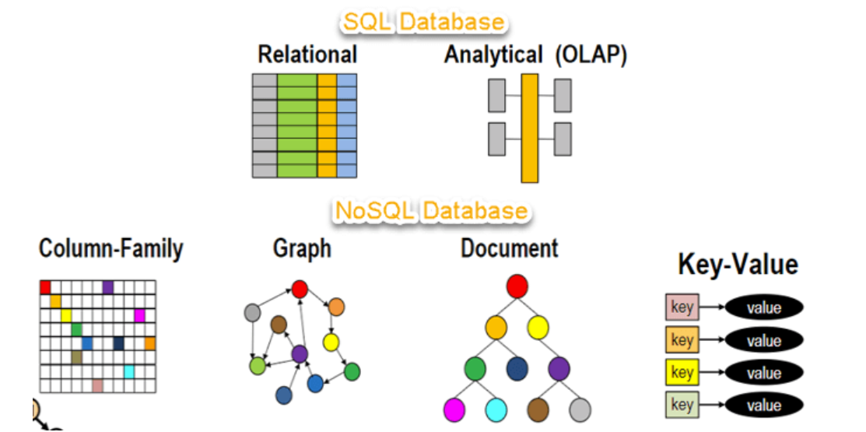
DATABASES AND APPLICATIONS
UNIT-IV- Non Relational Database Types

Slide 6
DATABASES AND APPLICATIONS
UNIT-IV- Non Relational Database Types
Key/Value Store
Key-value databases are a type of non-relational database that stores data as a collection of key-value pairs. Each data entry consists of a unique key and an associated value.
Features
Simple Data Model
High Performance
Scalability
Flexibility and Dynamic Schema
Caching

Slide 7
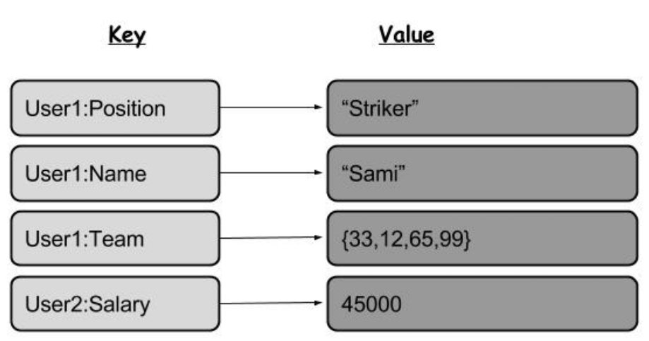
DATABASES AND APPLICATIONS
UNIT-IV- Key / Value Database
Key Value Structure

Slide 8
DATABASES AND APPLICATIONS
UNIT-IV- Key / Value Database: code in Aerospike
// Define a bin (Aerospike's term for key-value pairs)
const binName = 'value';
const binValue = 'example_value_updated';
// Write a record (key-value pair) to Aerospike
await client.put(key, { [binName]: binValue });
console.log('Record written to Aerospike');
// Read the record from Aerospike
const record = await client.get(key);
console.log('Retrieved record from Aerospike:', record.bins);
// Update the record
const updatedBinValue = 'updated_value';
await client.put(key, { [binName]: updatedBinValue });
console.log('Record updated in Aerospike');

Slide 9
DATABASES AND APPLICATIONS
UNIT-IV- Non Relational Database Types
Within a key-value database, only three functions can be executed (put, get, delete).
• Put: Adds a new key-value pair and updates the value if the
key is already present. • Get: Returns the value for any given key. • Delete: Removes a key-value pair.
Popular key-value Database store
Aerospike
Redis
Amazon DynamoDB (key-value store and document database)

Slide 10
DATABASES AND APPLICATIONS
UNIT-IV- Non Relational Database Types
Document Oriented Databases
Document-oriented databases, also known as document stores or document databases, are a type of non-relational database that stores and manages data in the form of semi-structured/unstructured documents. Example MongoDB.
The term “document” may refer to a MS Word, MS Excel, MS PowerPoint or Adobe PDF document but is commonly a block of extensible markup language (XML) or JavaScript object notation (JSON) code and values

Slide 11
DATABASES AND APPLICATIONS
UNIT-IV- Non Relational Database Types
Document Oriented Databases
Features
Document Model
Flexible Schema
Rich Querying
Handling Semi-Structured Data
Rich Datatype
Horizontal Scalability

Slide 12
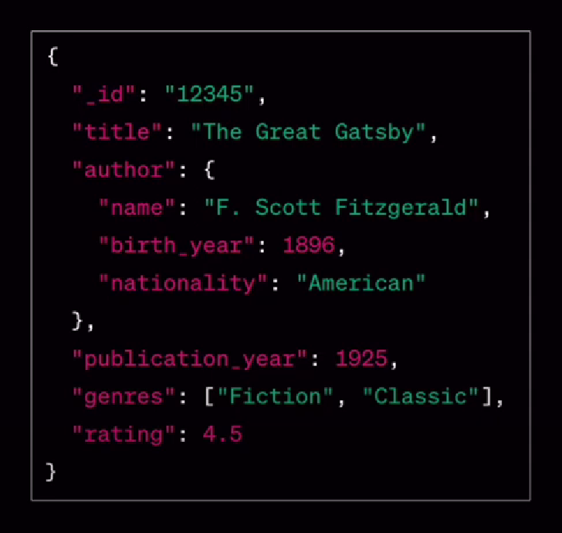
DATABASES AND APPLICATIONS
UNIT-IV- Example Document Database Book Repository

Slide 13

DATABASES AND APPLICATIONS
UNIT-IV- Example Document Database Book Repository

Slide 14
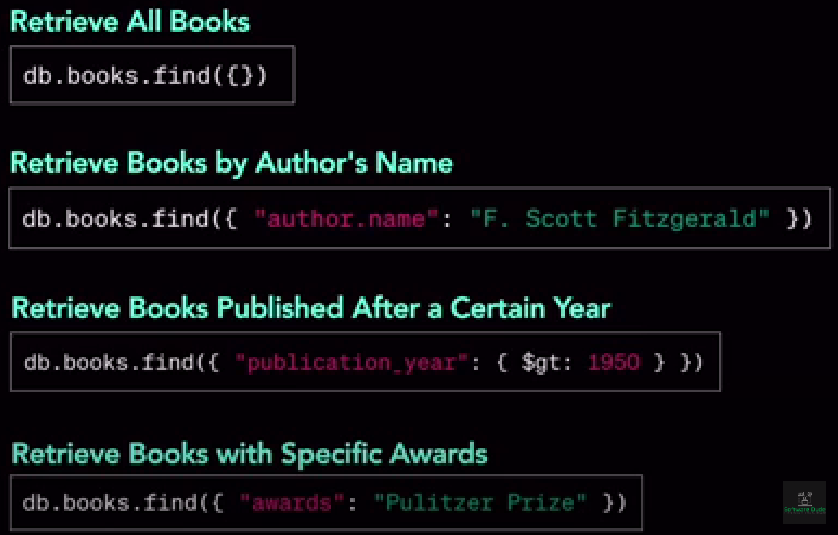
DATABASES AND APPLICATIONS
UNIT-IV- Example Document Database Book Repository

Slide 15
DATABASES AND APPLICATIONS
UNIT-IV- Non Relational Database Types
Applications of Document Oriented Databases
CMS(Content Management System)
E-Commerce Product Catalogs
User Profile Management and Personalization
Loggings and Event data Management
Collaboration Apps
Catalogs and Directories
Gaming
Health care and Medical Records
IOT
Chat Message Apps
Wikis and Knowledge based Apps
News and Media
Financial Apps
Location Based Services

Slide 16
DATABASES AND APPLICATIONS
UNIT-IV- Advantages of Document Database
A key advantage of a document database is that all values within the document are automatically indexed when a new document is insert into the database.
This means that if a user knows any property of the document, all documents with the same property can be easily retrieved.
And even if the document structure is complex, a document store search provides an easy way to select either an entire document or a sub-set of a document.

Slide 17
DATABASES AND APPLICATIONS
UNIT-IV- Document Database
List of popular Document Databases
MongoDB
Amazon DynamoDB
Microsoft Azure Cosmos DB
DataBricks
Couchbase( Cloud based database)
Google Cloud Datastore.

Slide 18

THANK YOU
Samyukta D Kumta
Department of Computer Applications
samyuktad@pes.edu

